Slide 1
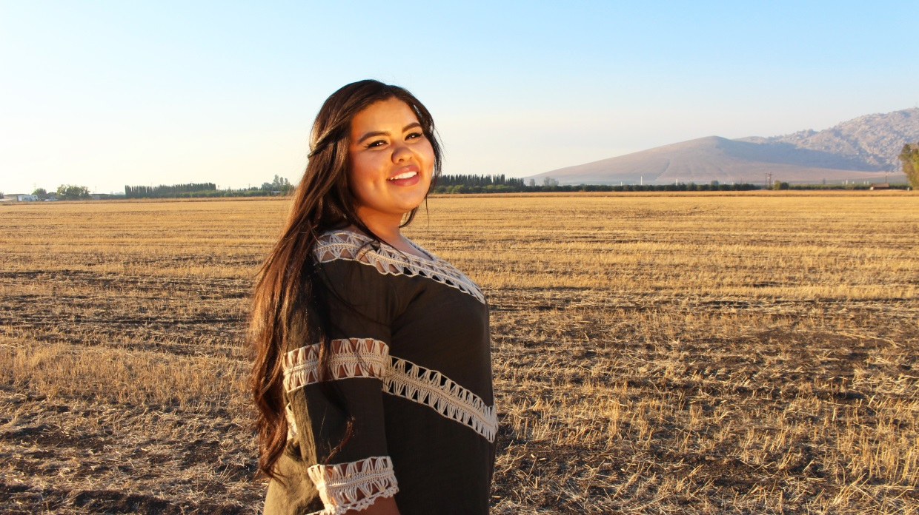
Yuritzy Tapia

Slide 2
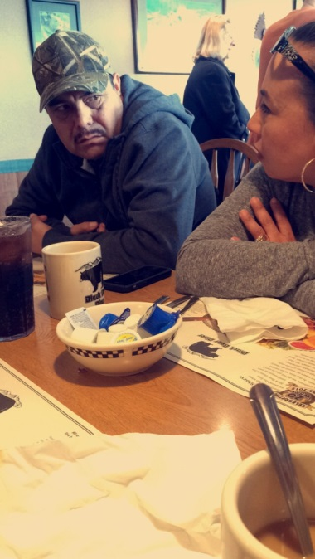
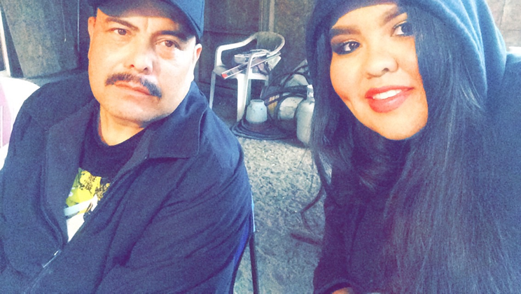
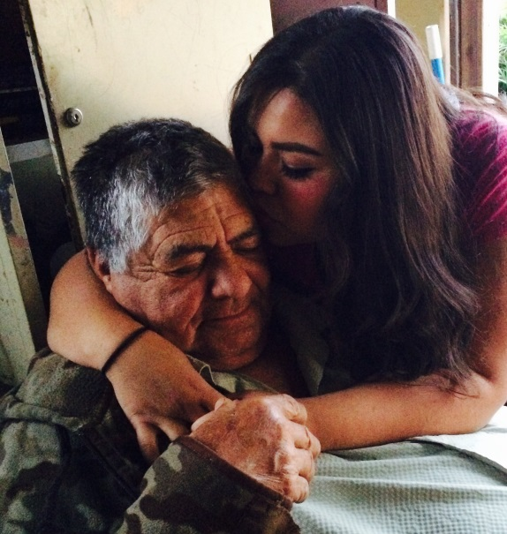
About Me
Born & Raised in Lindsay California
July 8, 1997
Family of 6
Interest:
Swimming
Shopping
Animal lover
Help others
Challenges
Having the highest expectation
Procastination

Slide 3
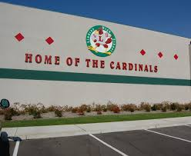
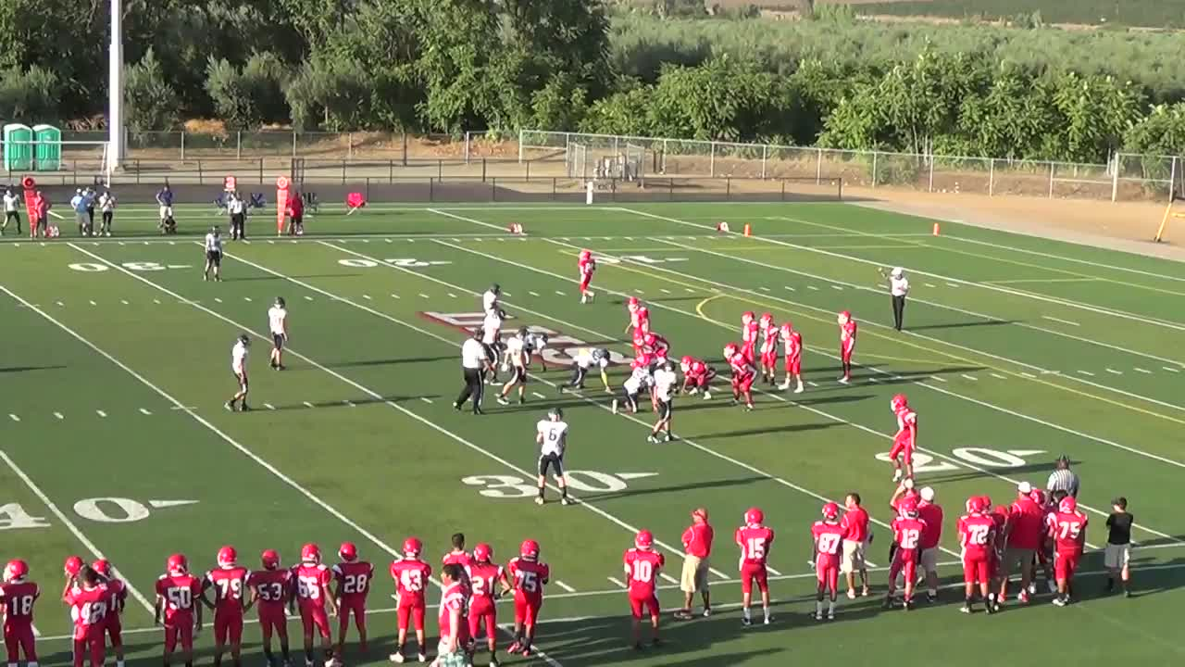
High School Experience
Clubs:
ASL
Art Club
FBLA
FFA
Prom Committee
Performance Based System
Work at my own pace
No deadlines
Personal challenges and successes
Procrastination
Being held back by family
Very unselfish person
Things I’ve learned
Need deadlines
College Preparation
Work well with others
Communication skills
Manage time wisely
Strive for greatness

Slide 4
Job Shadow
Office receptionist
Communication Skills
Deal with children
Deal with adults/Parents
Paperwork
Help others in the best way one can.
Enjoying the work schedule
Most memorable moment
Parents came in and I had to assist and help them
Not quiet for me

Slide 5
Pathway
Spanish
Allows me to communicate with others
Area
Spanish speaking parents
Spanish speaking learners
Read
Write better
Proper Spanish

Slide 6
Post-High School Plans
Attend Fresno State
Social Worker
Fresno suits me because
Close to home
Closer to Raider football
First to attend a university!
Very big deal
Being held back
Little support
Short term
Graduate Lindsay High School
Long term
Graduate college
Be successful
Give back

Slide 7
Leaving LHS
Feelings:
Devastated
Scared
Somewhat excited
LHS has been a blessing
Real world skills
Caring Leaning Facilitators
Performance based system has taught me:
Determination
Being organized
Stay on pace

Slide 8
Thank you!
Any questions?

